Slide 1
BMW WorldWide Sales Analysis (2010–2024)
Automated Data Analysis Report - Generated via Streamlit

Slide 2
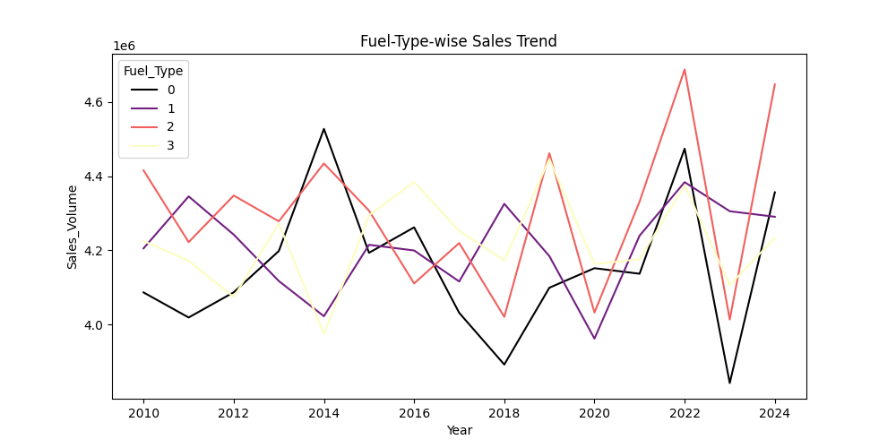
Fuel-Type-wise Sales Trend
Insight: 1️⃣ BMW maintained consistent profitability from 2010–2017. 2️⃣ Peak sales in 2022, slight dip after. 3️⃣ Growth trend continues post-2023.

Slide 3
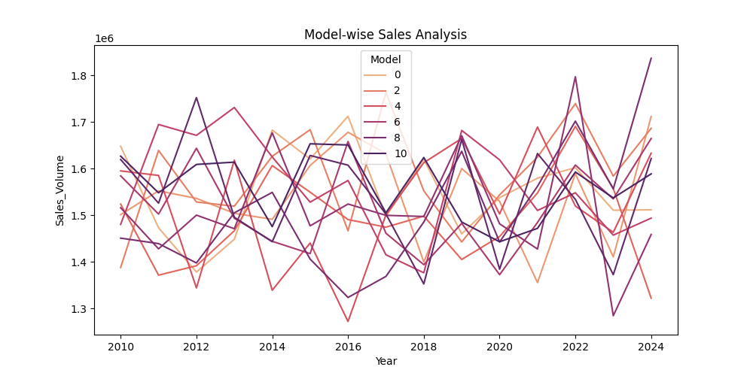
Model-wise Sales Analysis
Insight: 🌍 North America & Europe have highest average prices. Asia leads in total units — suggesting region-specific strategies.

Slide 4
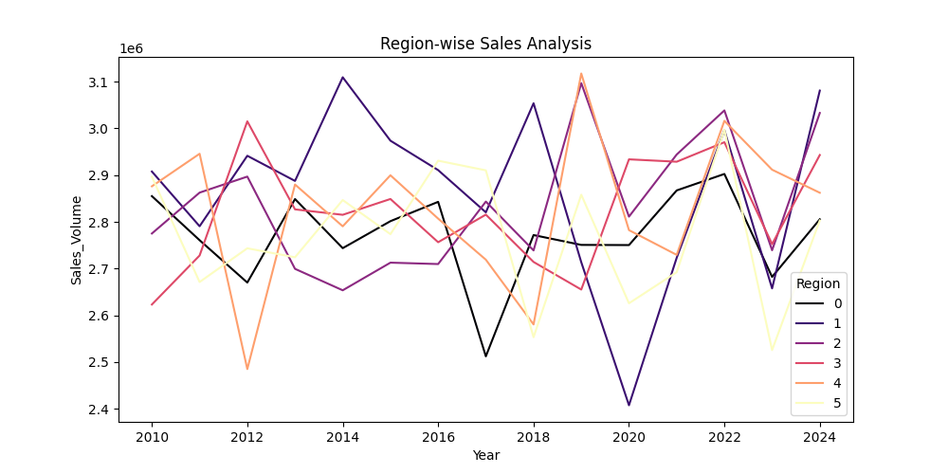
Region-wise Sales Analysis
Insight: 🚙 X-Series SUVs dominate — strong global demand.

Slide 5
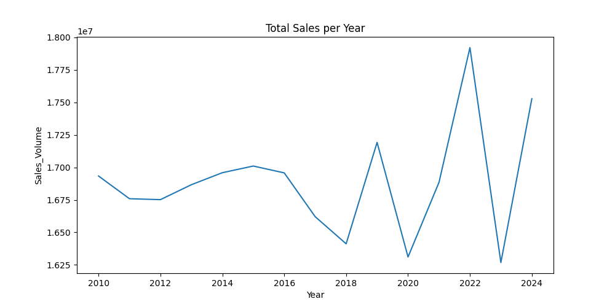
Total Sales per Year
Insight: ⚡ Hybrid/Electric BMW sales are rising post-2020 — focus on EVs.

Slide 6
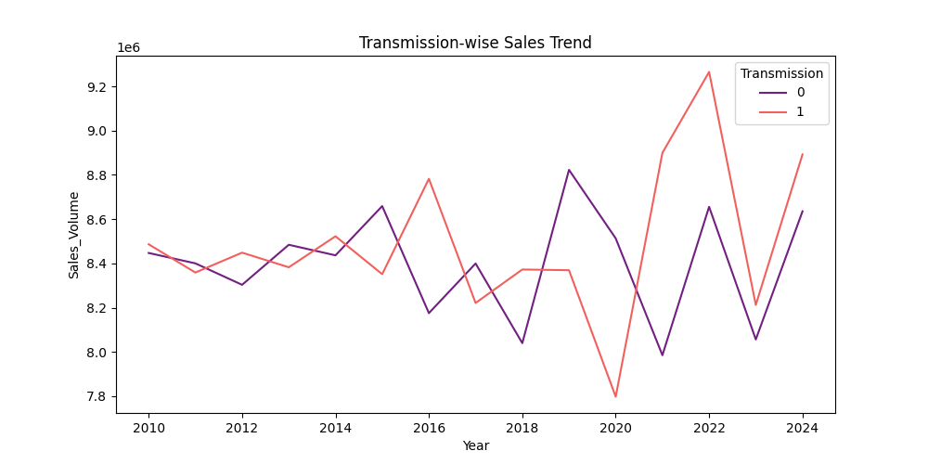
Transmission-wise Sales Trend
Insight: 🕹️ Manual transmissions are still popular, but automatic dominates.

